Slide 1


Globus in Action: Introduction to Globus for Research Data Management
Brian Roland
Data Management Specialist
Northwestern IT
Research Computing and Data Services

Slide 2
Agenda
What is Globus?
Why use Globus?
How to get started with Globus
Live Demo
Globus Collections
Setting up a Globus transfer
Transfer status/history
Data Sharing in Globus
Setting up Globus Connect Personal
Advanced Globus Features

Slide 3
What is Globus?
Globus is a powerful data management, transfer, and collaboration tool designed to simplify research workflows and empower users to securely manage and share large amounts of data from a variety of data storage platforms.

Slide 4
Why use Globus?
Used by research institutions and government facilities across the globe.
2600+ Connected Institutions
Makes data storage usage more accessible to researchers. Allows researchers to efficiently manage usage on a variety of storage systems.
Institutional Storage
Local Storage
Commercial cloud storage platforms
Developers can use Globus to automate data workflows leveraging the Globus API, SDK, and command line tools (Advanced)

Slide 5
Globus Features
Globus enables users to transfer and manage data between endpoints using advanced protocols that provide users with:
High performance data transfers optimized via GFTP
Automatic fault recovery and error checking
Fire and forget functionality
Encryption in transit (HTTPS)
Post-transfer file integrity verification

Slide 6
Globus Features
Additional key features of Globus provides include:
Web based user interface
Downloadable client that enables transfers to local machine storage (Globus Connect Personal)
Automation and scheduling functionality
Data Sharing capabilities

Slide 7
Getting started with Globus
Globus uses your netID and Password for authentication via Northwestern’s Single Sign-On Service (SSO)
Use of Globus at Northwestern University can only be used with data that is NOT legally or contractually restricted
Use of Globus with RDSS requires user to complete the Request Access to RDSS via Globus form.

Slide 8
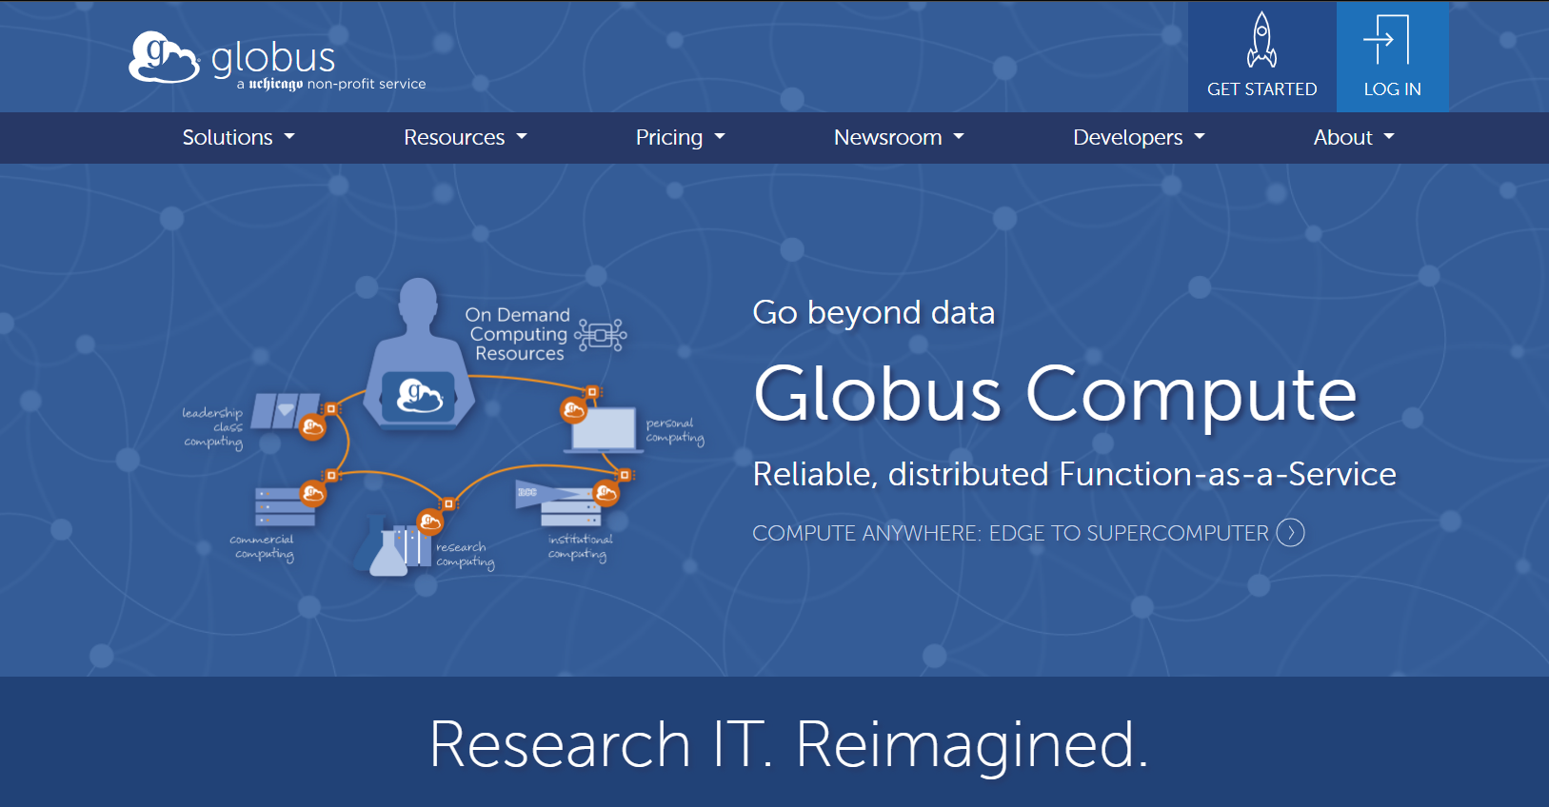
https://www.globus.org/

Slide 9
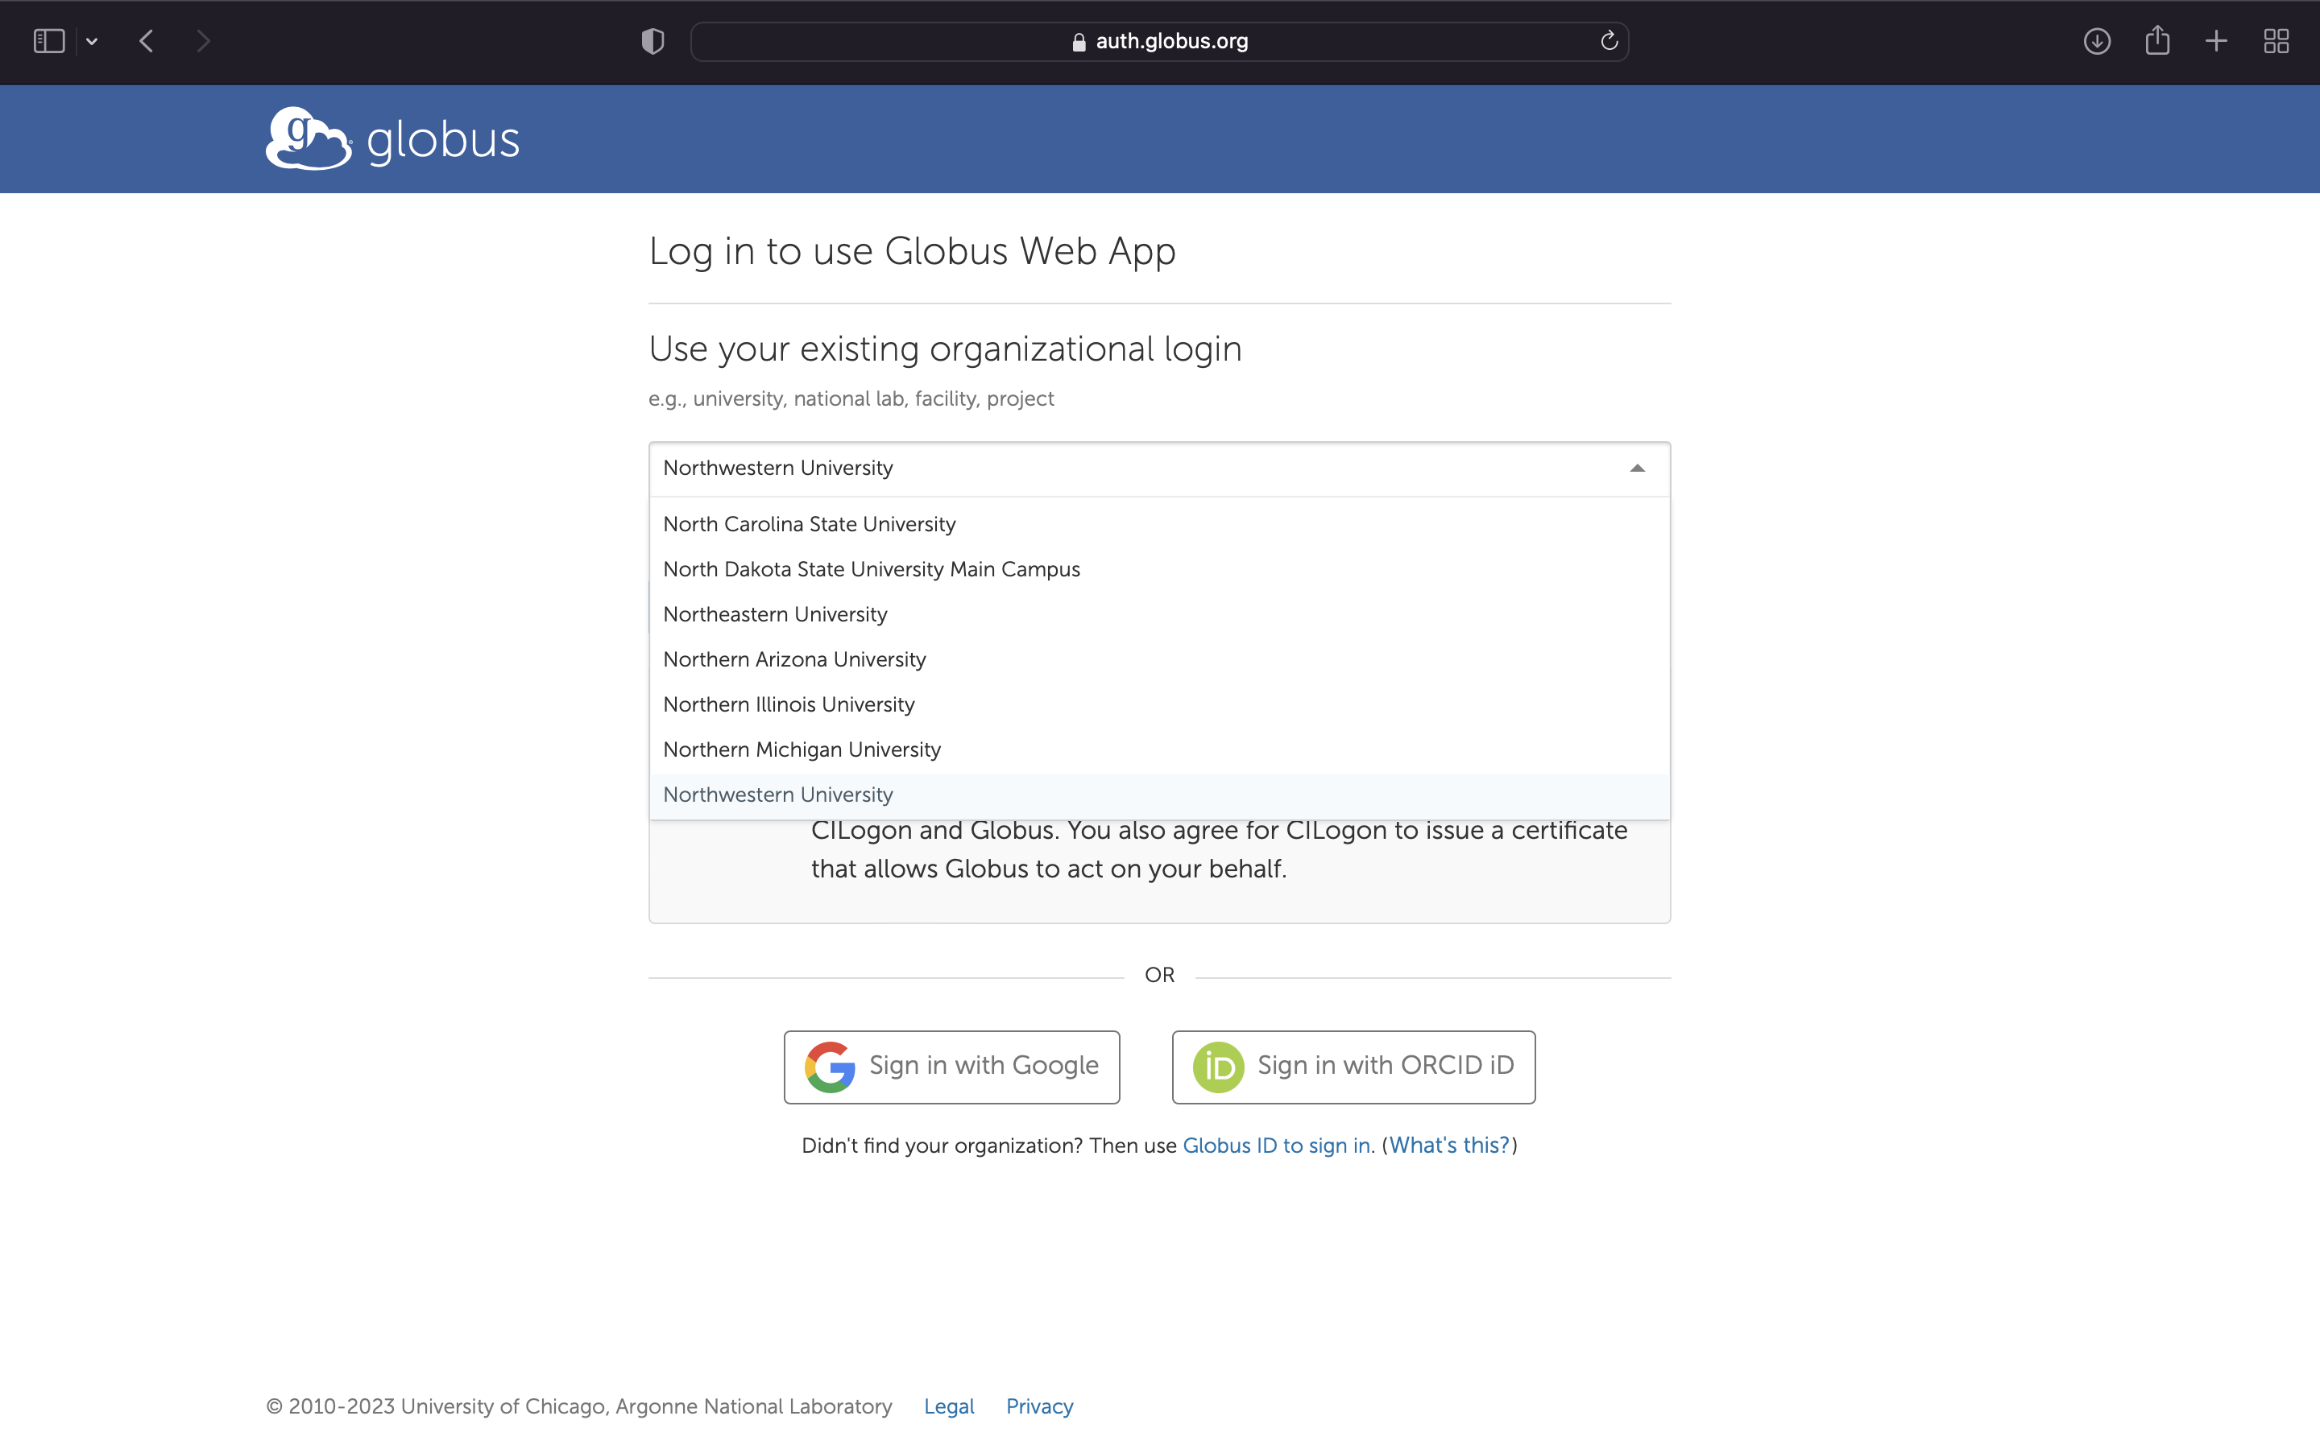
Logging in via NU Credentials

Slide 10
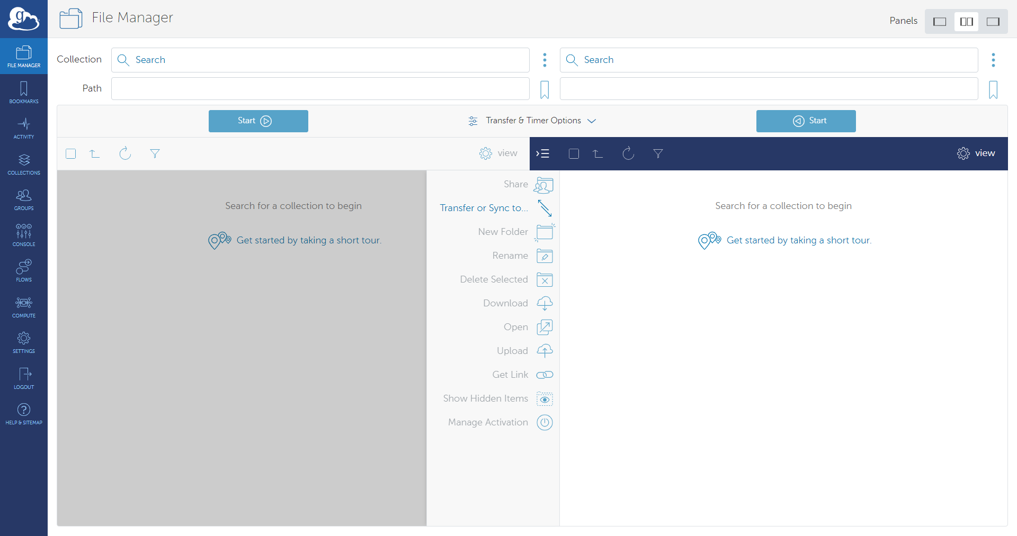
Navigation Menu
File Manager is where you will setup and submit globus transfers
Bookmarks is where you can find and manage shortcuts you to various Collections frequently accessed
Activity is where users can find the status of current transfers and a history of recently completed transfers.
Collections is where you can search information on publicly listed Globus Collections.
Groups is where you can create, manage, or request access to Globus groups that help manage permissions on Globus Collections
Settings is where you manage your Globus account including consents, Globus Group memberships, and the developer console.

Slide 11
How Does Globus Work?
Globus allows you to manage and transfer data between nodes they call Collections. Globus supports three types of Collections:
Managed Collections
Guest Collections
Globus Connect Personal Collections
Notes:
A collection is a logical grouping of files and/or directories that can be managed and shared together as a single entity.
A collection can be thought of as a container for data that can be accessed, transferred, shared, and managed as a unit.

Slide 12
Managed Collections
A Globus Managed Collection provides access to centrally administered storage platforms.
NU IT supports Managed Collections that provide access both on-prem and cloud-based storage systems
Notes:
Deployed by NU IT that allows authorized users access to specific NU IT supported storage platforms

Slide 13
Globus at Northwestern University
NU IT supports Globus Managed Collections that access both on-premises and cloud-based storage
On Campus
Off Campus
Quest Storage
Research Data Storage Service (RDSS)
File Storage services
Cloud Providers
Home directory
Amazon Web Service
SharePoint
Project directory
resfiles
OneDrive
Microsoft Azure
resfiles-audit
Global Scratch Space
Google Drive
Google Cloud Platform
fsmresfiles

Slide 14
Northwestern Managed Collections
Name | UUID
Northwestern Quest | d5990400-6d04-11e5-ba46-22000b92c6ec
Northwestern Quest RDSS | 8f796c9e-f5c8-11e5-9842-22000b9da45e
Northwestern AWS us-east-1 N. Virginia | bf0474ea-df2f-45f6-82e3-41d062d84ce7
Northwestern AWS us-east-2 Ohio | a14148f0-23dc-488f-affd-bd981f919b10
Northwestern AWS us-west-2 Oregon | 880cd765-5d14-43f6-97a6-2dbb355f3560
Northwestern OneDrive Pilot* | 930c2fcb-416e-4540-a757-496f86acbe70
*Provides access to both OneDrive and SharePoint

Slide 15
Globus and RDSS
Globus access to RDSS must be requested so that NU IT can configure your Globus access to specific RDSS share paths.
To submit a request for access, please submit the Request Access to RDSS via Globus Form found in the NU IT Service Catalog. In the form you will need to include the following information:
NetID
Full share path:
//resfiles.northwestern.edu/SHARENAME/
//fsmresfiles.fsm.northwestern.edu/fsmresfiles/DEPARTMENT/LAB/

Slide 16
Guest Collections
A Globus Guest Collection is a shared storage space within Globus that provides collaborators to access designated data.
Allows researchers to collaborate with external partners without compromising data security.
Notes:
Shared collections are hosted on either managed collections or Globus Connect Personal collections.
Shared collections are required if sharing data with external collaborators.
The owner of the shared collection defines the highest-level path that can be accessed, sets user access, and the user permissions are inherited by any subfolders.

Slide 17
Globus Connect Personal Collections
A Globus Connect Personal Collection is enabled by installing the Globus Connect Personal client on a local machine.
Globus Connect Personal Collections allow for efficient transfers between local storage and other Globus endpoints.

Slide 18
Globus Connect Personal
Download Globus Connect Personal
Supports Mac, Windows, and Linux machines
During installation, the user will need to log into Globus and provide consent for Globus to access the local file system
It is recommended that a globally unique name is used for the Globus Connect Personal Collection during the installation process
Notes:
Works with firewalls that block incoming connections.
Uses proven Globus infrastructure for security and authentication.
User can define the paths locally that are made available to Globus

Slide 19
File Manager: Setting up your transfer
Source Collection
Destination Collection

Slide 20
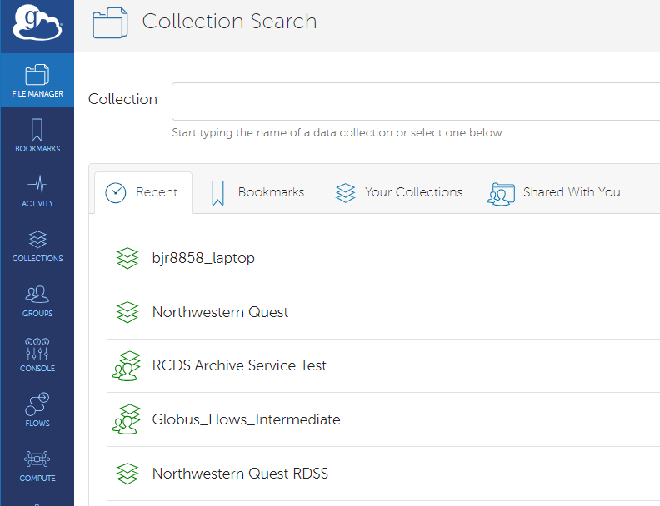
File Manager: Selecting Globus Collections
Clicking on the Collection field for either the Source or Destination of the data transfer, opens a new page that includes a search field where you can enter the name or UUID for the Collection you wish to access
The Collection Search page will have tabs that will list:
Recently used Collections (Recent)
Bookmarks you created for quick access to Collections and paths on that Collection
Your Collections that you own. These can be Guest Collections or your Globus Connect Personal Connections
Guest Collections created by other users where you have been provided access permissions (Shared With You)

Slide 21
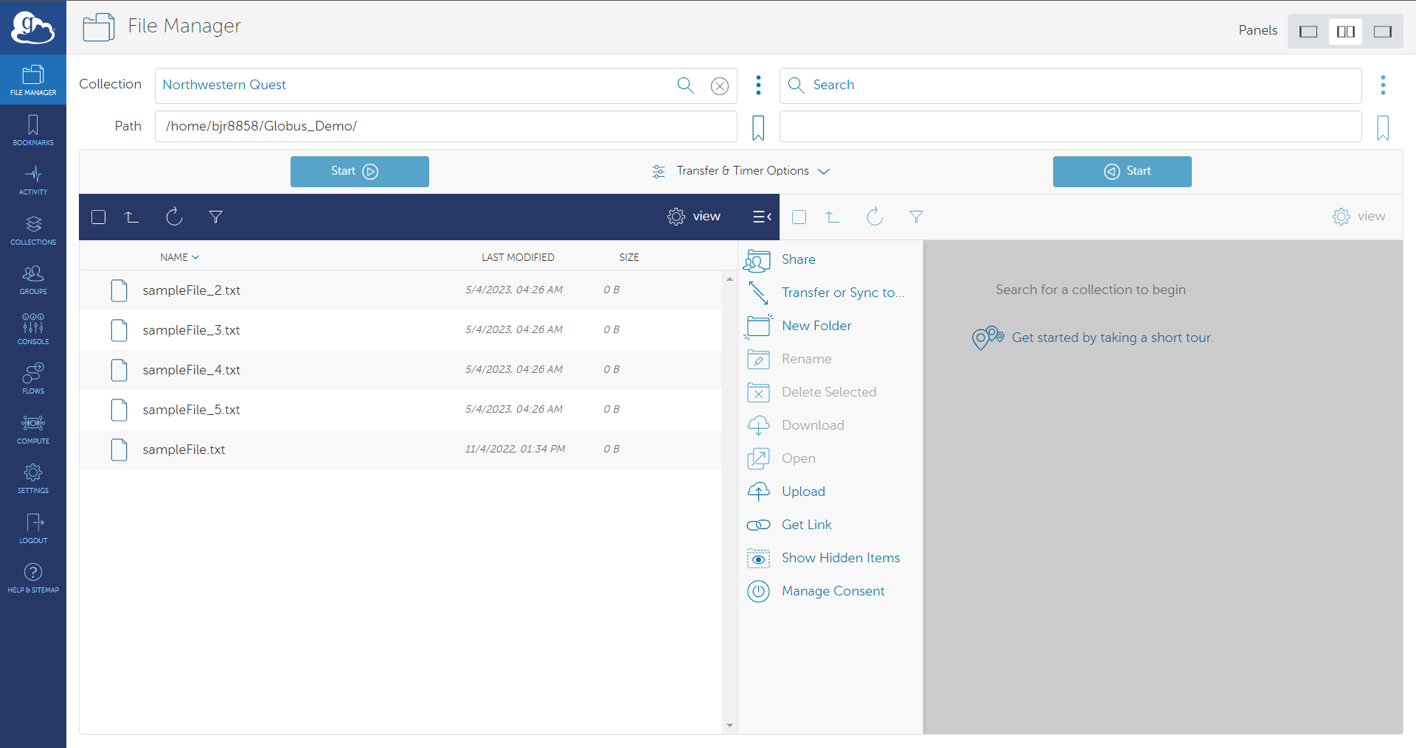
File Manager: Selecting Data Source
Once you select a Collection, you can navigate to the specific path they want to access. This can be done manually in the Path field or by navigating the file explorer using the Globus interface.
Globus will display the files and subdirectories in the path provided. The user will be able to select which files and directories they want to transfer from the data source.

Slide 22
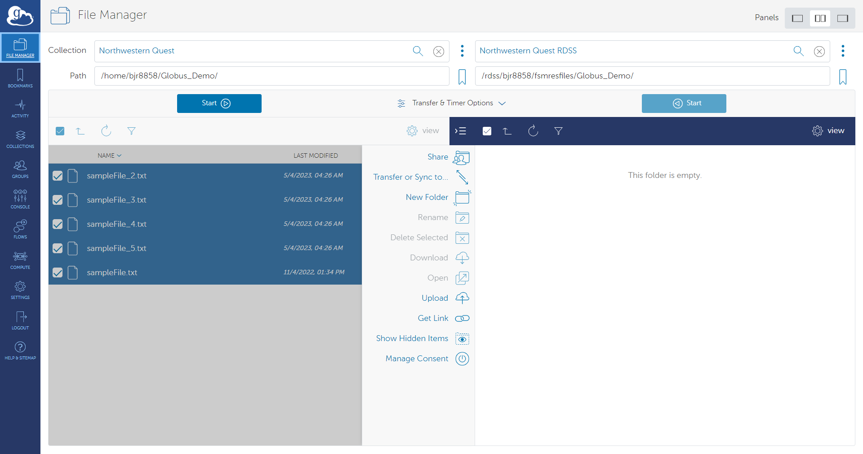
File Manager: Selecting Data Destination
Follow the same steps as selecting the data source for the data destination. You need to select the Collection name or enter the UUID in the blank Collection field in the 2nd panel.
Once you select a Collection, you define the path or navigate to the folder that will be the final destination for the data transfer.
Globus will display any files and subdirectories that already exist in the path provided.

Slide 23
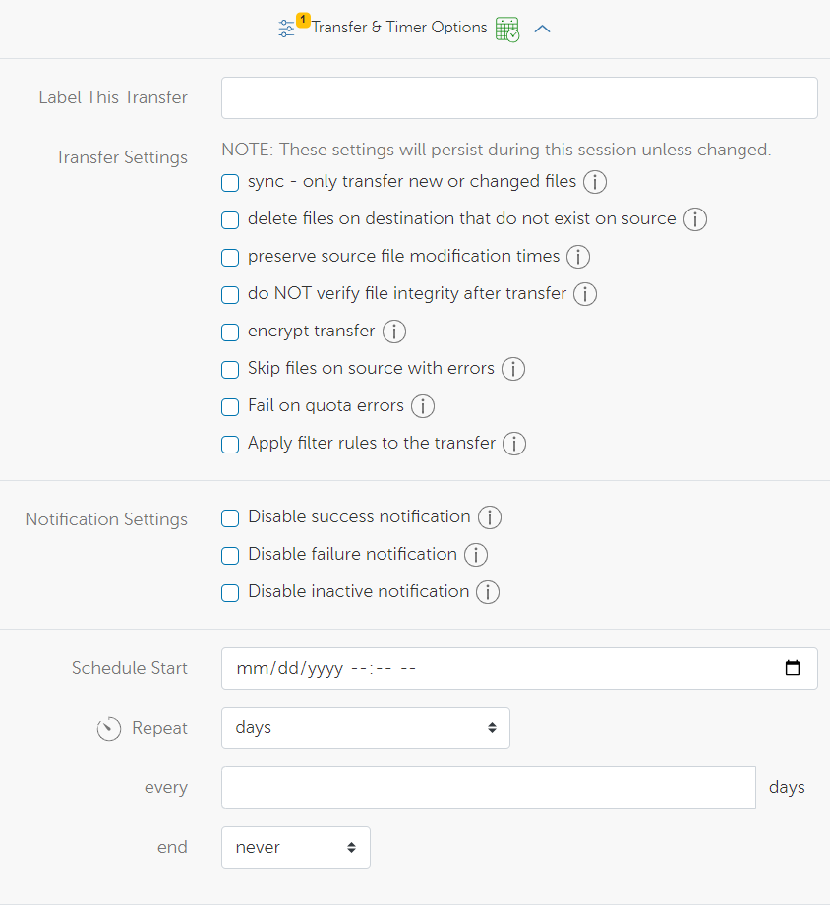
File Manager: Transfer & Timer Options

Slide 24
Recommended Transfer Options
Sync: Files will only be transferred if it meets a selected criteria when comparing the source to the destination of the transfer. Criteria include:
Modification time is newer
File size is different
File does not exist on destination
File checksum is different
Preserve Source file modification times
Encrypt Transfer: Data in your files will be encrypted while in transit. Both endpoints must support encryption to ensure a successful transfer.
Skip files on source with errors: Files on source with "file not found" and "permission denied" errors will be skipped rather than causing the entire transfer procedure to fail.

Slide 25
File Manager: Submitting Transfer

Slide 26
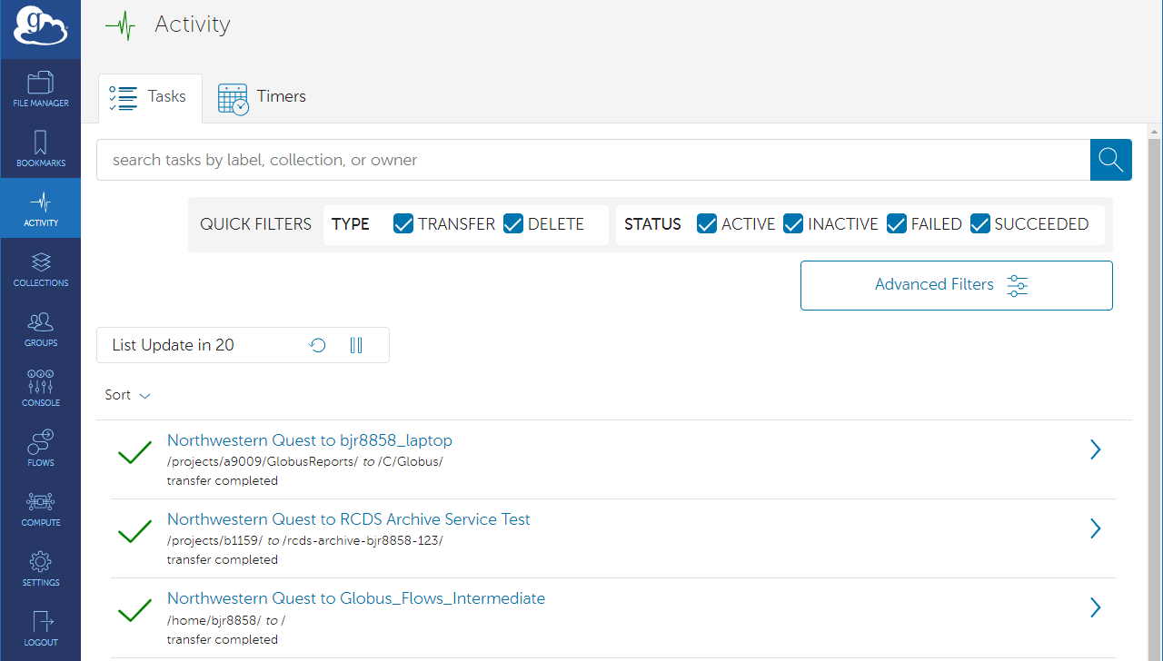
Monitoring Globus transfer status

Slide 27
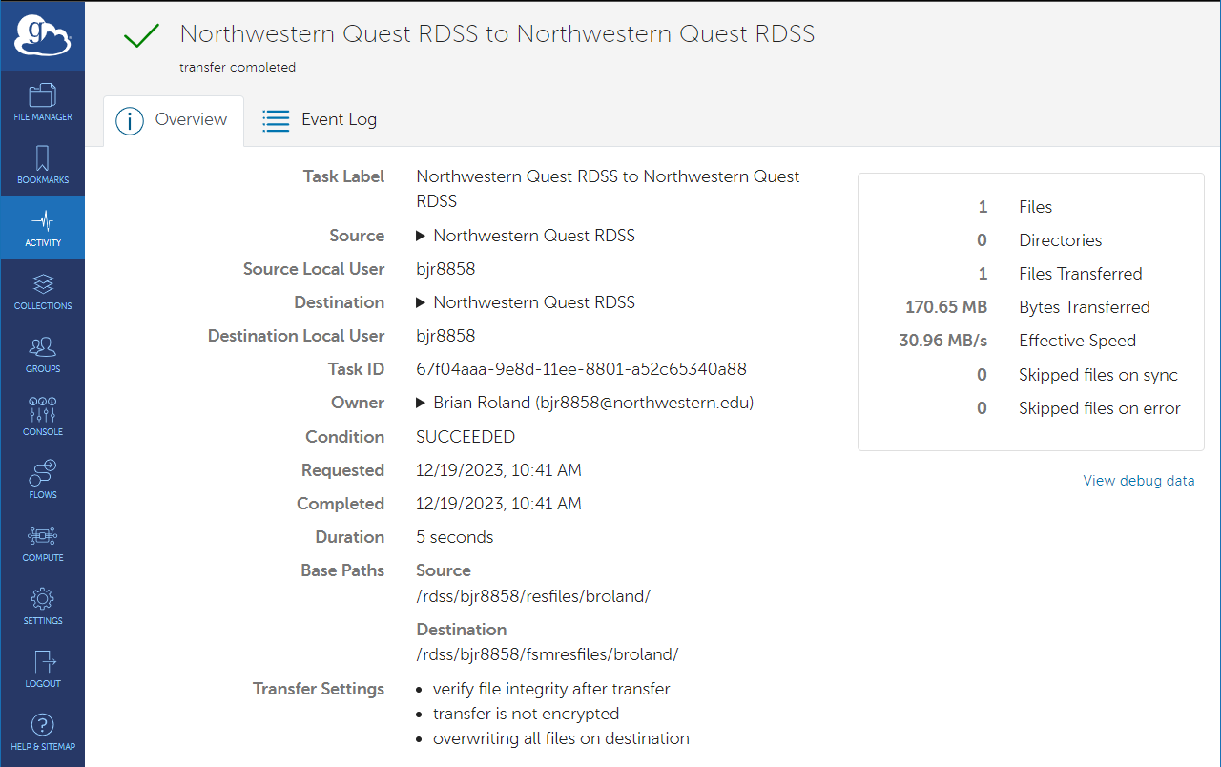
Monitoring Globus transfer status: Overview

Slide 28
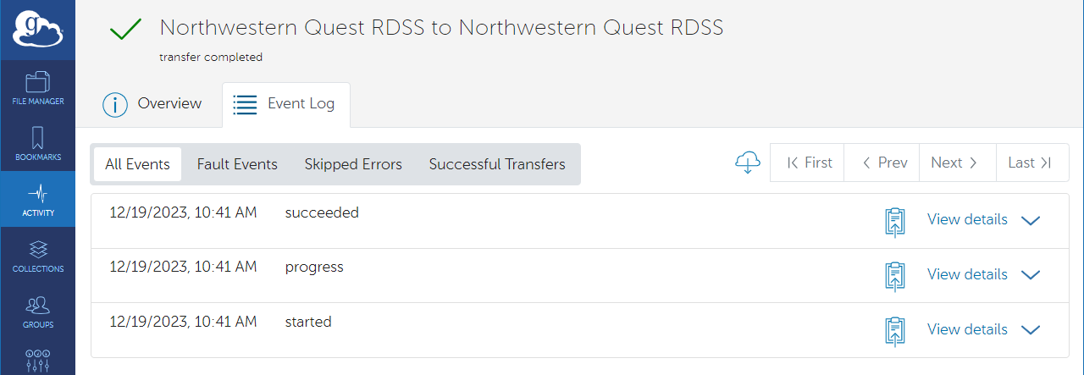
Monitoring Globus transfer status: Event Log

Slide 29
Data Sharing
Sharing data with Northwestern collaborators as well as external collaborators is made easy via Globus Guest Collections
To setup a Guest Collection, navigate to the File Manager and select a Managed or Globus Connect Personal Collection in the Collection field.
Once a Collection is selected, click on the Share link/icon to the right of the Collection
The Globus interface will next show a list of publicly listed Guest Collections. You will need to click on Add Guest Collection in the upper right-hand corner of the page

Slide 30
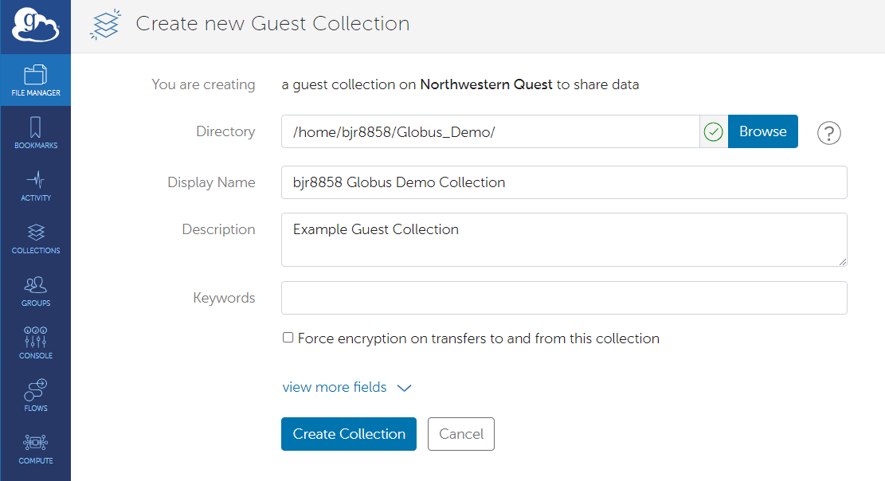
Data Sharing: Setup Guest Collection
You will be asked to define the root directory for the Guest Collection. This will be the highest-level directory that the Guest Collection can access.
You are required to enter a display name for the Guest Collection. This name does not need to be Globally unique, but a unique name is recommended.
Once you have defined the Directory and Display Name for the Guest Collection, you will be able to then create the Guest Collection by clicking the Create Collection button
You will then be shown Permissions information on the Guest Collection. To share this Collection with collaborators you need to click on Add Permissions – Share With

Slide 31
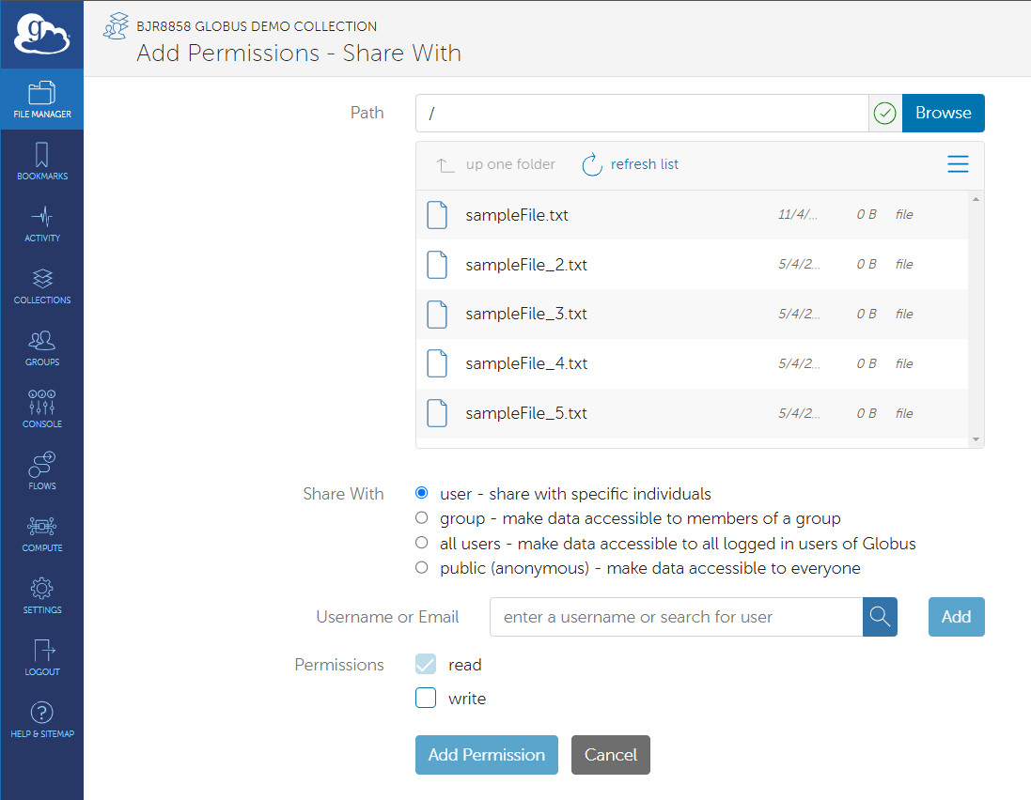
Data Sharing: Guest Collection Permissions
A new page will be displayed that will have a field to define the highest-level directory on the Guest collection that the collaborator(s) can access.
You then select the individual user or Globus group that you want to access the Guest Collection.
Read and Write permissions can be assigned to the user or group you are providing access via the Guest Collection.
By clicking Add Permission, you finalize providing the user or group access to the Guest Collection and the underlying data.

Slide 32
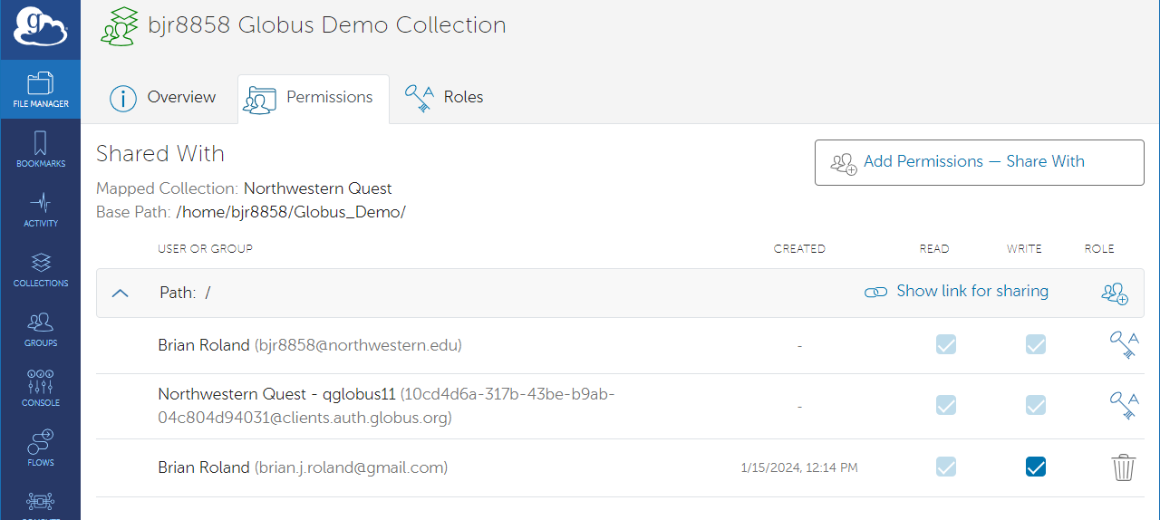
Data Sharing: Setup Guest Collection
When done adding permissions, Globus returns you to the Permissions page of the Guest Collection where it lists all who have access to the Guest Collection

Slide 33
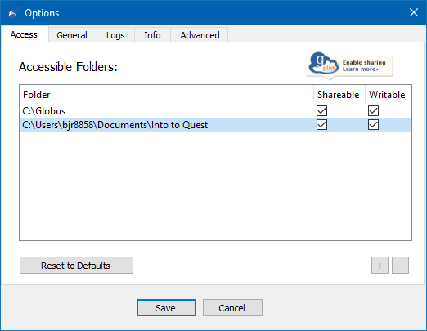
Globus Connect Personal: Settings
Once you have completed the Globus Connect Personal installation a Globus icon of a lower-case g in a blue circle will appear in the system tray or menu bar of the operating system
To configure your Globus Connect Personal Collection, use the right mouse button on the icon to display the context menu. You will then want to select Options or Preferences
A new window will appear that will list the local folders accessible by Globus Connect Personal. You can keep the default location or add/remove folders via the +/- buttons in the lower right-hand corner of the page.

Slide 34
Globus Connect Personal: Settings
You have the option to make the accessible folders writable or shareable by clicking the checkbox in the appropriate column
Once locations have been added/removed, as well as the shareable/writable options, you can commit the changes by clicking Save
After committing the changes, the locations on your local machine will be available via your Globus Connect Personal Collection
If Shareable is enabled on a location, you will be able to share that location with users via a Guest Collection

Slide 35
Advanced Globus Features
Globus Groups
Collaborative spaces within the Globus platform that facilitate organized and secure teamwork.
Globus CLI
A command-line tool provided by Globus for interacting with the Globus service through the terminal.
Globus SDK
A collection of libraries, tools, and resources provided by Globus to simplify the development of applications and services that interact with the Globus platform.

Slide 36
Globus Groups
Enables you to create groups, invite members, and manage access permissions for efficient data sharing.
Provides control over who can access shared resources, ensuring data security and privacy.

Slide 37
Globus CLI
Globus provides the Globus CLI, a command line tool for interacting with the Globus service through the terminal.
The Globus CLI is available on Quest as part of software and applications commonly used on Quest.
Available version: Globus-cli/3.5.0

Slide 38
Globus SDK
The Globus SDK is a collection of libraries, tools, and resources provided by Globus to simplify the development of applications and services that interact with the Globus platform
Offers pre-built functions and utilities for common tasks

Slide 39
Globus Resources
Globus Resources
NU KB Articles
Globus Documentation
Globus Connect Personal
How To Share Data Using Globus
How to configure firewall policy for Globus Connect Personal
Globus Command Line Interface (CLI) Reference
Using the Globus Data Transfer Tool
Using the RDS Globus Endpoint
Using Globus with Amazon S3 Object Storage
Using the OneDrive/SharePoint Globus Collection

Slide 40
Questions? globus-help@northwestern.edu We are excited to be holding in-person consultation hours on Mondays from 3-4pm at the Mudd Library GIS Lab (2nd Floor across from the bridge to Tech).

